Slide 2
Vision services
computer
Frances Tibble, @frances_tibble

Slide 3

Vision
Language
Speech
Search
Knowledge
Computer vision
Face
Emotion
Content Moderator
Video
Video Indexer
Text analytics
Spell check
Web language model
Linguistic analysis
Translator Text
Translator Speech
Speaker recognition
Bing Speech
Web search
Image search
Video search
News search
Autosuggest
Entity search
Academic knowledge
Entity linking service
Knowledge exploration
Recommendations
QnA maker
Custom
Custom
Custom
Custom
Custom
Vision Service
Language Understanding
Speech Service
Search
Decision Service
+6 Cognitive Services Labs APIs

Slide 4
COMPUTER VISION
Computer Vision
Face
Emotion
Content Moderator
Video
Video Indexer
Custom Vision Service
APIs TO EXTRACT VISUAL INFORMATION FROM IMAGES AND VIDEO
Notes:
The purpose of the computer vision APIs is to enable us to more easily extract visual information, and understand that as text.
Broadly we have APIs for analysing images, those include the computer vision API, things like Face, Emotion, and our Content Moderator API.
Then we have the Video Indexing service which can pull out similar information from a video.
Finally, with all our computer vision services, there’s a custom offering – and that’s what our workshop will be on today.

Slide 5

Computer Vision
Analyse an image
Read text in images

Slide 6

Face and Emotion
Face Detection
Picking out one or many faces
Face Recognition
Similarity in features, age, gender
Emotion
Are you happy, sad, surprised?

Slide 7
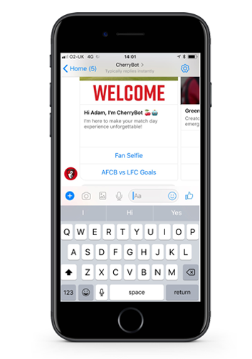
Cherry bot
Notes:
Actually, it is more like clippy on steroids
Clippy was first introduced in Office 97 and lasted through to Office 2013.
It spotted when you were doing something like writing a letter and offered to help you out with it.
The assistive intent is the core of Microsoft’s AI approach and represents a difference between strong AI and weak AI

Slide 8
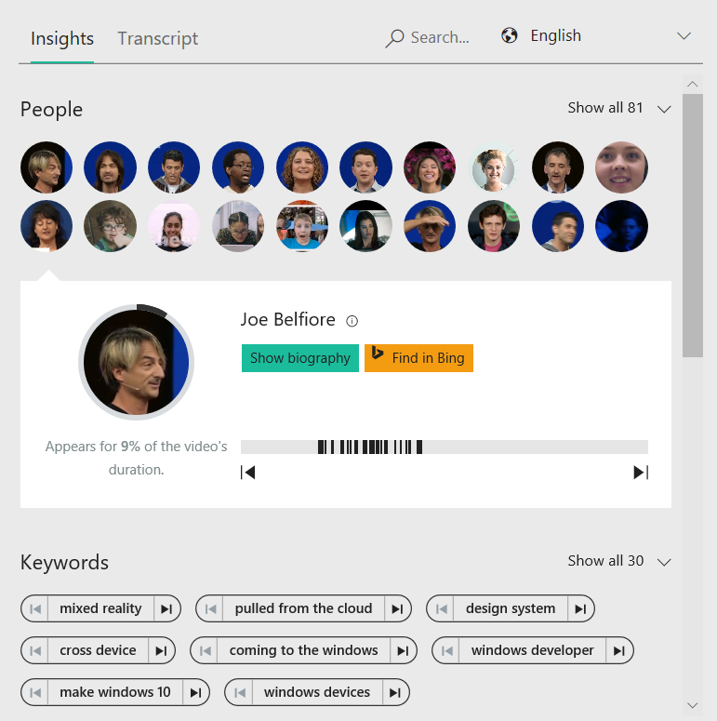
Video Indexer
Content tagging
Sentiment analysis
Face detection

Slide 9

Custom Vision
Build your own model
Can be used offline

Slide 10
Lab

Slide 11
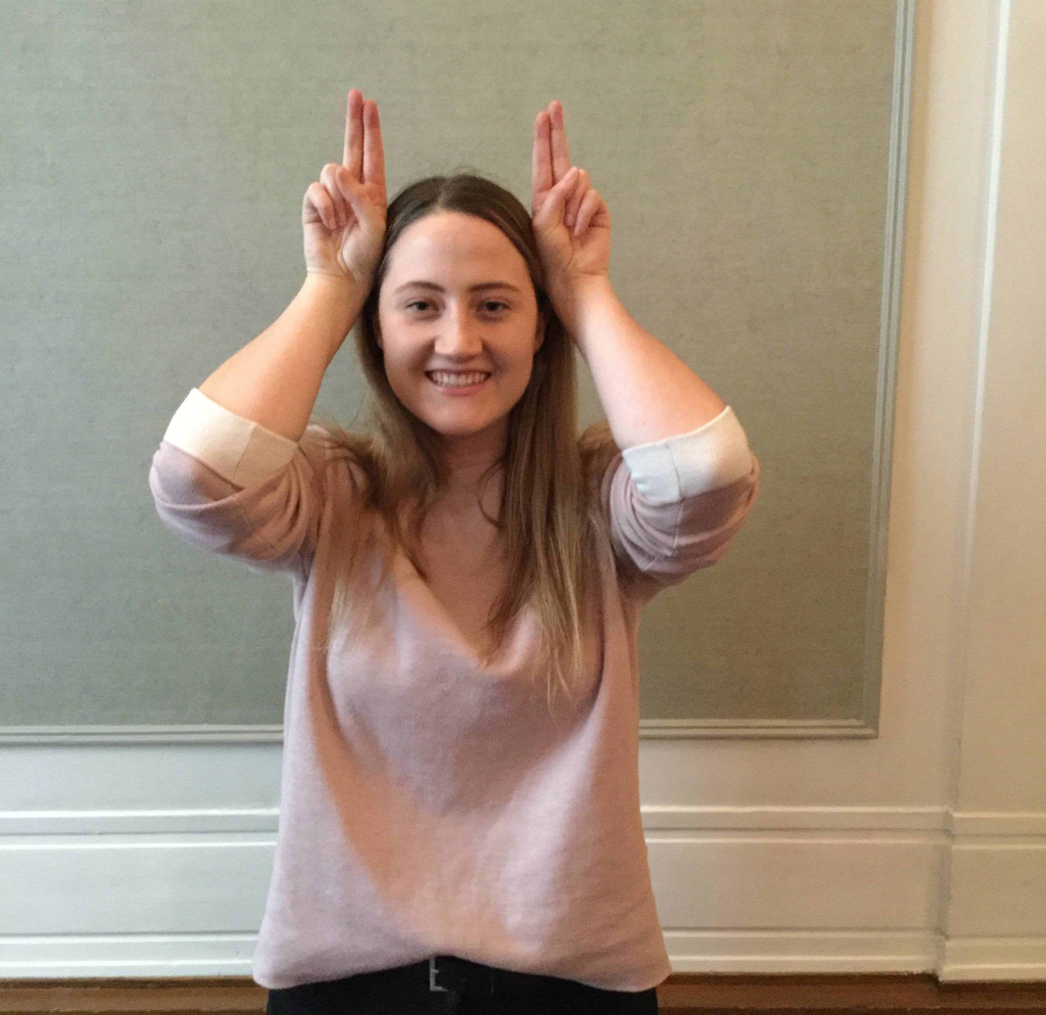
Contact Me
Frances Tibble
@frances_tibble
Frances.Tibble@Microsoft.com

